Slide 1

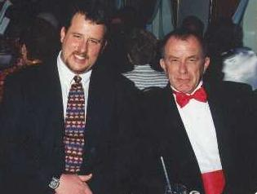
Exposure Java 2015
APCS Edition
Chapter 14 Slides
Focus on OOP: Polymorphism
PowerPoint Presentation
created by:
Mr. John L. M. Schram
and Mr. Leon Schram
Authors of Exposure Java

Slide 2
Section 14.1
Introduction

Slide 3
OOP Review
Object Oriented Programming (OOP) is a style of programming that incorporates these 3 features:
Encapsulation
Class Interaction
Polymorphism

Slide 4
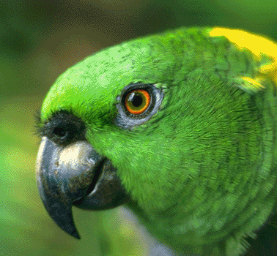
Polymorphism
Polymorphism allows something
to have many forms.
It aids reliability by making every object responsible for its own actions.

Slide 5
Section 14.2
Overloaded
Operators
and Methods

Slide 6

Addition & Concatenation
100 + 200 = 300 (this is addition)
“100” + “200” = “100200” (this is concatenation)
This shows that the plus sign ( + ) is an overloaded operator.

Slide 7
// Java1401.java
// The < + > operator in Java is overloaded.
// This program shows that the same operator can perform
// arithmetic addition and string concatenation.
public class Java1401
{
public static void main (String[] args)
{
int n1 = 1000;
int n2 = 2000;
int n3 = n1 + n2;
String s1 = "1000";
String s2 = "2000";
String s3 = s1 + s2;
System.out.println();
System.out.println("n1 + n2 = " + n3);
System.out.println();
System.out.println("s1 + s2 = " + s3);
System.out.println();
}
}
n1 + n2 = 3000
s1 + s2 = 10002000

Slide 8
// Java1402.java
// This program draws four squares with four different
// <drawSquare> methods.
// There are no overloaded methods.
public class Java1402 extends Applet
{
public void paint(Graphics g)
{
drawSquare1(g);
drawSquare2(g,200,300);
drawSquare3(g,Color.blue,600,200);
drawSquare4(g,Color.green,500,400,200);
}
public void drawSquare1(Graphics g)
{
g.setColor(Color.black);
g.fillRect(100,100,150,150);
}

Slide 9
public void drawSquare2(Graphics g, int x, int y)
{
g.setColor(Color.red);
g.fillRect(x,y,150,150);
}
public void drawSquare3(Graphics g, Color color, int x, int y)
{
g.setColor(color);
g.fillRect(x,y,150,150);
}
public void drawSquare4(Graphics g, Color color, int x, int y, int side)
{
g.setColor(color);
g.fillRect(x,y,side,side);
}
}

Slide 10
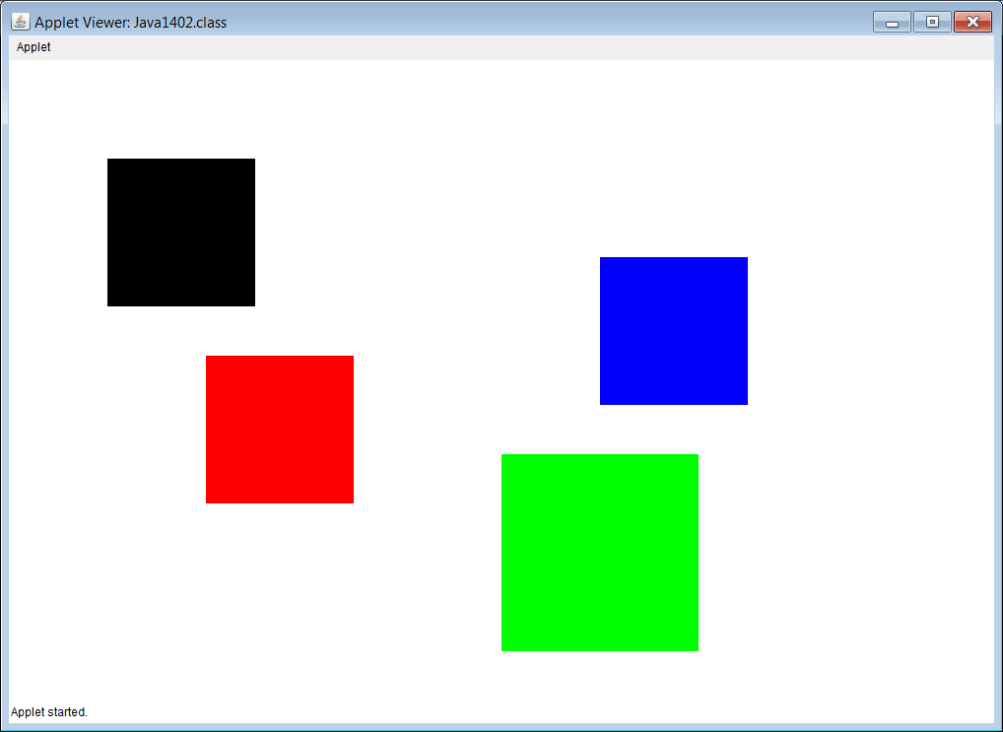

Slide 11
// Java1403.java
// This program draws four different squares with the
// same <drawSquare> method. Each method has a different
// parameter signature. These are overloaded methods.
public class Java1403 extends Applet
{
public void paint(Graphics g)
{
drawSquare(g);
drawSquare(g,200,300);
drawSquare(g,Color.blue,600,200);
drawSquare(g,Color.green,500,400,200);
}
public void drawSquare(Graphics g)
{
g.setColor(Color.black);
g.fillRect(100,100,150,150);
}

Slide 12
public void drawSquare(Graphics g, int x, int y)
{
g.setColor(Color.red);
g.fillRect(x,y,150,150);
}
public void drawSquare(Graphics g, Color color, int x, int y)
{
g.setColor(color);
g.fillRect(x,y,150,150);
}
public void drawSquare(Graphics g, Color color, int x, int y, int side)
{
g.setColor(color);
g.fillRect(x,y,side,side);
}
}

Slide 13


Slide 14
Section 14.3
Polymorphism
with an Interface

Slide 15

Umbrella Example 1
Language obj1 = new English();
Language obj2 = new German();
Language obj3 = new Dutch();
Language obj4 = new French();
Language is an umbrella interface in this example.

Slide 16
Umbrella Example 2
The following 4 separate announcements…
being made to 4 separate classes of students:
9th graders go to the gymnasium at 10:00am.
10th graders go to the gymnasium at 10:00am.
11th graders go to the gymnasium at 10:00am.
12th graders go to the gymnasium at 10:00am.
could be reduced to 1 announcement…
with 1 Umbrella: students
All students go to the gymnasium at 10:00am.

Slide 17
// Java1404.java
// This program displays the output of four different classes
// with the same <greeting> method.
// This program uses neither inheritance nor polymorphism.
public class Java1404
{
public static void main (String[ ] args)
{
English g1 = new English();
German g2 = new German();
Dutch g3 = new Dutch();
French g4 = new French();
g1.greeting();
g2.greeting();
g3.greeting();
g4.greeting();
}
}
In English you say Good Day
In German you say Guten Tag
In Dutch you say Goeden Dag
In French you say Bonjour

Slide 18



class English
{
public void greeting()
{
System.out.println("In English you say Good Day");
}
}
class German
{
public void greeting()
{
System.out.println("In German you say Guten Tag");
}
}
class Dutch
{
public void greeting()
{
System.out.println("In Dutch you say Goeden Dag");
}
}
class French
{
public void greeting()
{
System.out.println("In French you say Bonjour");
}
}

Slide 19
// Java1405.java
// This program uses a <Language> interface
// with four implementing classes.
public class Java1405
{
public static void main (String[] args)
{
English g1 = new English();
German g2 = new German();
Dutch g3 = new Dutch();
French g4 = new French();
g1.greeting();
g2.greeting();
g3.greeting();
g4.greeting();
}
}
In English you say Good Day
In German you say Guten Tag
In Dutch you say Goeden Dag
In French you say Bonjour

Slide 20
abstract interface Language
{
public abstract void greeting();
}
class English implements Language
{
public void greeting() { System.out.println("In English you say Good Day"); }
}
class German implements Language
{
public void greeting() { System.out.println("In German you say Guten Tag"); }
}
class Dutch implements Language
{
public void greeting() { System.out.println("In Dutch you say Goeden Dag"); }
}
class French implements Language
{
public void greeting() { System.out.println("In French you say Bonjour"); }
}

Slide 21
// Java1406.java
// In this program a very convoluted
// method is used to print the greeting
// for each language.
public class Java1406
{
public static void main (String[] args)
{
English g1 = new English();
German g2 = new German();
Dutch g3 = new Dutch();
French g4 = new French();
printGreeting(g1);
printGreeting(g2);
printGreeting(g3);
printGreeting(g4);
}
public static void printGreeting(Object g)
{
if (g instanceof English)
{
English temp = (English) g;
temp.greeting();
}
else if (g instanceof German)
{
German temp = (German) g;
temp.greeting();
}
else if (g instanceof Dutch)
{
Dutch temp = (Dutch) g;
temp.greeting();
}
else if (g instanceof French)
{
French temp = (French) g;
temp.greeting();
}
}
}
In English you say Good Day
In German you say Guten Tag
In Dutch you say Goeden Dag
In French you say Bonjour

Slide 22
class English
{
public void greeting()
{
System.out.println("In English you say Good Day");
}
}
class German
{
public void greeting()
{
System.out.println("In German you say Guten Tag");
}
}
class Dutch
{
public void greeting()
{
System.out.println("In Dutch you say Goeden Dag");
}
}
class French
{
public void greeting()
{
System.out.println("In French you say Bonjour");
}
}

Slide 23
// Java1407.java
// This program uses polymorphism with a very simple <printGreeting> method.
// The <Language> interface is the "umbrella".
public class Java1407
{
public static void main (String[] args)
{
Language g1 = new English();
Language g2 = new German();
Language g3 = new Dutch();
Language g4 = new French();
printGreeting(g1);
printGreeting(g2);
printGreeting(g3);
printGreeting(g4);
}
public static void printGreeting(Language obj)
{
obj.greeting();
}
}
In English you say Good Day
In German you say Guten Tag
In Dutch you say Goeden Dag
In French you say Bonjour

Slide 24
abstract interface Language
{
public abstract void greeting();
}
class English implements Language
{
public void greeting() { System.out.println("In English you say Good Day"); }
}
class German implements Language
{
public void greeting() { System.out.println("In German you say Guten Tag"); }
}
class Dutch implements Language
{
public void greeting() { System.out.println("In Dutch you say Goeden Dag"); }
}
class French implements Language
{
public void greeting() { System.out.println("In French you say Bonjour"); }
}

Slide 25
// Java1408.java
// This program uses polymorphism in a different way.
// The "umbrella" <Language> is now used as the element for an <ArrayList> object.
import java.util.ArrayList;
public class Java1408
{
public static void main (String[] args)
{
Language g1 = new English();
Language g2 = new German();
Language g3 = new Dutch();
Language g4 = new French();
ArrayList<Language> languages = new ArrayList<Language>();
languages.add(g1);
languages.add(g2);
languages.add(g3);
languages.add(g4);
for (Language language : languages)
language.greeting();
}
}
In English you say Good Day
In German you say Guten Tag
In Dutch you say Goeden Dag
In French you say Bonjour

Slide 26
Section 14.4
Polymorphism
with a Superclass

Slide 27
// Java1409.java
// In this program polymorphism is achieved
// using an abstract superclass as the umbrella.
public class Java1409
{
public static void main (String[] args)
{
Language g1 = new English();
Language g2 = new German();
Language g3 = new Dutch();
Language g4 = new French();
printGreeting(g1);
printGreeting(g2);
printGreeting(g3);
printGreeting(g4);
}
public static void printGreeting(Language obj)
{
obj.greeting();
}
}
In English you say Good Day
In German you say Guten Tag
In Dutch you say Goeden Dag
In French you say Bonjour

Slide 28
abstract class Language
{
public abstract void greeting();
}
class English extends Language
{
public void greeting() { System.out.println("In English you say Good Day"); }
}
class German extends Language
{
public void greeting() { System.out.println("In German you say Guten Tag"); }
}
class Dutch extends Language
{
public void greeting() { System.out.println("In Dutch you say Goeden Dag"); }
}
class French extends Language
{
public void greeting() { System.out.println("In French you say Bonjour"); }
}

Slide 29
// Java1410.java
// In this program polymorphism is achieved
// using a superclass as the umbrella.
public class Java1410
{
public static void main (String[] args)
{
Language g1 = new English();
Language g2 = new German();
Language g3 = new Dutch();
Language g4 = new French();
printGreeting(g1);
printGreeting(g2);
printGreeting(g3);
printGreeting(g4);
}
public static void printGreeting(Language obj)
{
obj.greeting();
}
}
In English you say Good Day
In German you say Guten Tag
In Dutch you say Goeden Dag
In French you say Bonjour

Slide 30
class Language
{
public void greeting()
{
System.out.println("Every language has a greeting.");
}
}
class English extends Language
{
public void greeting() { System.out.println("In English you say Good Day"); }
}
class German extends Language
{
public void greeting() { System.out.println("In German you say Guten Tag"); }
}
class Dutch extends Language
{
public void greeting() { System.out.println("In Dutch you say Goeden Dag"); }
}
class French extends Language
{
public void greeting() { System.out.println("In French you say Bonjour"); }
}

Slide 31
Section 14.5
Interface or
Superclass?

Slide 32
// Java1411.java
// This program shows a type of polymorphism that
// cannot be done with an interface umbrella.
public class Java1411
{
public static void main (String[] args)
{
Actor belle = new Belle();
Actor maurice = new Maurice();
Actor gaston = new Gaston();
Actor beast = new Beast();
actDetails(belle);
actDetails(maurice);
actDetails(gaston);
actDetails(beast);
}
public static void actDetails(Actor obj)
{
obj.act();
}
}

Slide 33
class Actor
{
public void act()
{
System.out.println("Every actor needs a costume.");
System.out.println("Every actor also enters and exits the stage.");
}
}
class Belle extends Actor
{
public void act()
{
super.act();
System.out.println("Belle is spirited and head strong.");
System.out.println("Belle likes to read books.");
System.out.println("She does not like Gaston.");
System.out.println("She learns to like Beast.");
System.out.println();
}
}
class Maurice extends Actor
{
public void act()
{
super.act();
System.out.println("Maurice is Belle's father.");
System.out.println("He is also a scientist.");
System.out.println();
}
}

Slide 34
class Gaston extends Actor
{
public void act()
{
super.act();
System.out.println("Gaston likes to show off his muscles.");
System.out.println("He wants to marry Belle.");
System.out.println("He tries to kill Beast.");
System.out.println();
}
}
class Beast extends Actor
{
public void act()
{
super.act();
System.out.println("Beast lives alone in a castle.");
System.out.println("He keeps Belle at the castle and dances with her.");
System.out.println("Beast falls in love with Belle.");
System.out.println();
}
}

Slide 35
Every actor needs a costume.
Every actor also enters and exits the stage.
Belle is spirited and head strong.
Belle likes to read books.
She does not like Gaston.
She learns to like Beast.
Every actor needs a costume.
Every actor also enters and exits the stage.
Maurice is Belle's father.
He is also a scientist.
Every actor needs a costume.
Every actor also enters and exits the stage.
Gaston likes to show off his muscles.
He wants to marry Belle.
He tries to kill Beast.
Every actor needs a costume.
Every actor also enters and exits the stage.
Beast lives alone in a castle.
He keeps Belle at the castle and dances with her.
Beast falls in love with Belle.

Slide 36
// Java1412.java
// The <act> method is now called from a loop that
// traverses an array with the umbrella <Actor> superclass.
import java.util.ArrayList;
public class Java1412
{
public static void main (String[] args)
{
ArrayList<Actor> actors = new ArrayList<Actor>();
Actor belle = new Belle();
Actor maurice = new Maurice();
Actor gaston = new Gaston();
Actor beast = new Beast();
actors.add(belle);
actors.add(maurice);
actors.add(gaston);
actors.add(beast);
for (Actor actor : actors)
actor.act();
}
}

Slide 37
Interface or Superclass?
If the umbrella (interface or superclass) has no legitimate functionality
(Example: Language)
then use an interface.
If there is a common functionality shared by all classes under the umbrella
(Example: Actor)
then use a superclass.

Slide 38
Section 14.6
How does
Polymorphism work?

Slide 39
Quote from
An Introduction to Polymorphism by Dan Umbarger
The term homonym means "a word the same as another in sound and spelling but with different meaning. The term bear could be a verb (to carry a burden) or it could be a noun (a large hairy mammal). One can distinguish between the two usages through the use of context clues.

Slide 40
Elegant Polymorphic Code
for (Actor actor : actors)
actor.act();

Slide 41
Polymorphism & Reliability
In a complex program with hundreds or more classes and many, many similar, but different actions it is very easy to get confused and instruct some object to behave incorrectly.
This will not happen if each object carries its own set of instructions and is told to act, to display, to compute, etc.
This specific set of instructions is not selected until runtime when the method is called and a connection is made between the method and the class where it is re-defined in a process that is called late-binding.

Slide 42
Cookies & Polymorphism
In our technology world polymorphism is very much alive and few people know that it exists or how it works.
Suppose that you browse on Amazon.com and you do some searches on Star Wars movies and novels. You make no purchases and you leave the site.
A week later you return to Amazon and magically some suggestions pop up about the latest Star wars novels and newly enhanced movies you can purchase.
How does Amazon know who you are and what you like? Yes you can be a regular customer and you may have logged in, which then brings up a profile, but thousands, if not millions of customers do not immediately create a profile and use logins.

Slide 43
Cookies & Polymorphism
The secret is cookies. A cookie is a small file stored on your computer with some type of relevant information. You browse Amazon and Amazon checks if cookies are enabled on your computer. If so, information about your browsing habits are stored on your personal computer. Next time that you go to Amazon, your computer is checked for cookies and Bingo an appropriate suggestion about purchasing something pops up.
Consider this cookie process like method suggest and it is polymorphic according to the customer's computer. Is it reliable? You bet, because millions of people have different tastes and these individual tastes are stored on their own computer.
Incidentally, this cookie business is not something peculiar to Amazon. Many online companies use this technology. Individuals who object to this type of technology can change the settings on their computer to "disable" cookies.

Slide 44
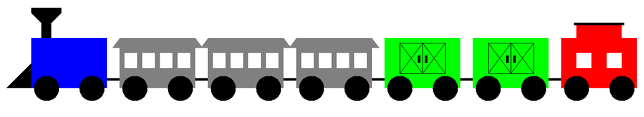
Section 14.7
The Choo-Choo
Train Inheritance

Slide 45
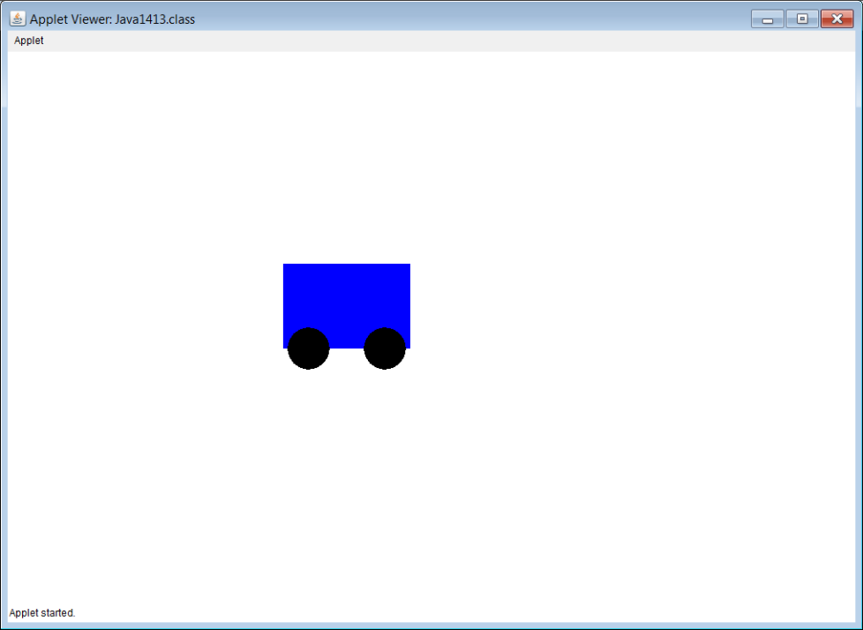
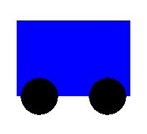
// Java1413.java
// Train case study, Stage #1
// The first stage starts with the <RailCar> class.
// The rail car has a fixed location and position.
// Three objects all display in top of each other.
import java.awt.*;
import java.applet.*;
public class Java1413 extends Applet
{
public void paint(Graphics g)
{
RailCar rC1 = new RailCar();
RailCar rC2 = new RailCar();
RailCar rC3 = new RailCar();
rC1.drawCar(g);
rC2.drawCar(g);
rC3.drawCar(g);
}
}
class RailCar
{
private Color carColor;
public RailCar()
{
carColor = Color.blue;
}
public void drawCar(Graphics g)
{
g.setColor(carColor);
g.fillRect(325,250,150,100);
g.setColor(Color.black);
g.fillOval(330,325,50,50);
g.fillOval(420,325,50,50);
}
}

Slide 46
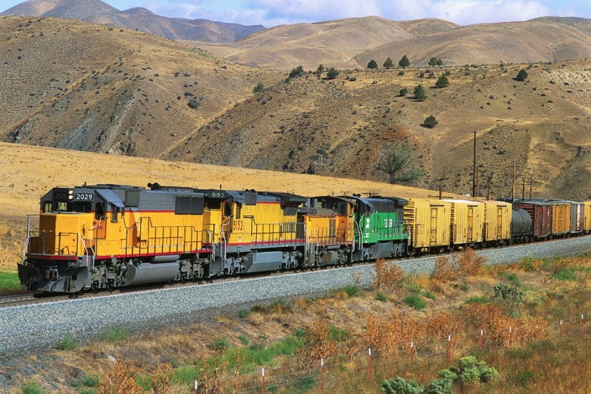
// Java1414.java
// Train case study, Stage #2
// This program improves the <RailCar> class by constructing
// new objects with a specified color and a specified location.
import java.awt.*;
import java.applet.*;
public class Java1414 extends Applet
{
public void paint(Graphics g)
{
RailCar rc1 = new RailCar(Color.blue,100,250);
RailCar rc2 = new RailCar(Color.green,275,250);
RailCar rc3 = new RailCar(Color.yellow,450,250);
RailCar rc4 = new RailCar(Color.magenta,625,250);
rc1.drawCar(g);
rc2.drawCar(g);
rc3.drawCar(g);
rc4.drawCar(g);
}
}

Slide 47
private void drawContainer(Graphics g)
{
g.setColor(carColor);
g.fillRect(xPos,yPos,150,100);
}
private void drawRailWheels(Graphics g)
{
g.setColor(Color.black);
g.fillOval(xPos+5,yPos+75,50,50);
g.fillOval(xPos+95,yPos+75,50,50);
}
private void drawLink(Graphics g)
{
g.setColor(Color.black);
g.fillRect(xPos-25,yPos+80,25,5);
}
}
class RailCar
{
private Color carColor;
private int xPos;
private int yPos;
public RailCar(Color cC, int xP, int yP)
{
carColor = cC;
xPos = xP;
yPos = yP;
}
public void drawCar(Graphics g)
{
drawContainer(g);
drawRailWheels(g);
drawLink(g);
}

Slide 48
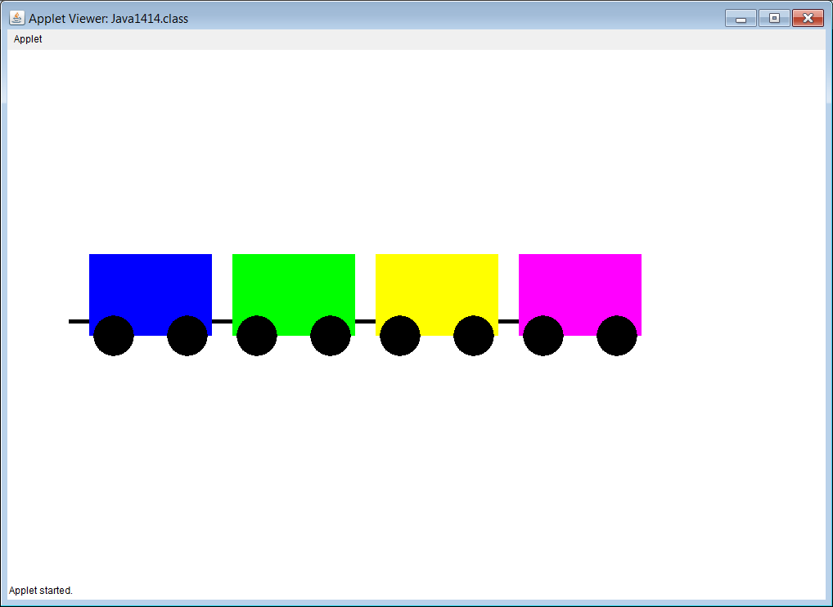

Slide 49
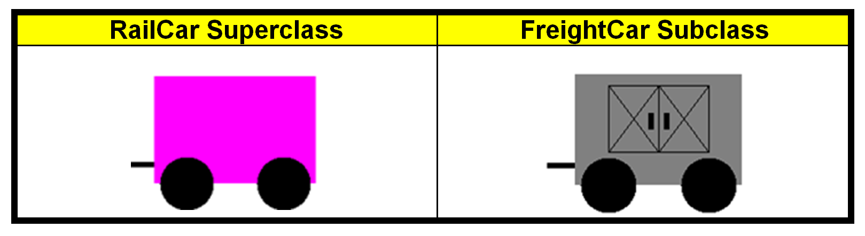
Train Case Study – Stage 3
Create a FreightCar class.

Slide 50
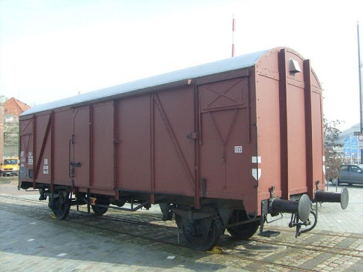
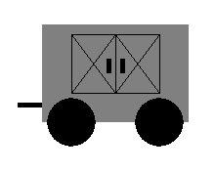
// Java1415.java
// Train case study, Stage #3
// This program adds the <FreightCar>
// class, using inheritance, since a freight
// car is-a rail car.
import java.awt.*;
import java.applet.*;
public class Java1415 extends Applet
{
public void paint(Graphics g)
{
FreightCar loc =
new FreightCar(Color.gray,70,250);
loc.drawCar(g);
}
}
class FreightCar extends RailCar
{
private Color carColor;
private int xPos;
private int yPos;
public FreightCar(Color cC, int xPos, int yPos)
{
super(cC,xPos,yPos);
carColor = cC;
this.xPos = xPos;
this.yPos = yPos;
}
public void drawCar(Graphics g)
{
super.drawCar(g);
drawFreightDoors(g);
}
private void drawFreightDoors(Graphics g)
{
g.setColor(Color.black);
g.drawRect(xPos+30,yPos+10,90,60);
g.drawLine(xPos+75,yPos+10,xPos+75,yPos+70);
g.drawLine(xPos+30,yPos+10,xPos+75,yPos+70);
g.drawLine(xPos+30,yPos+70,xPos+75,yPos+10);
g.drawLine(xPos+75,yPos+10,xPos+120,yPos+70);
g.drawLine(xPos+75,yPos+70,xPos+120,yPos+10);
g.fillRect(xPos+66,yPos+35,5,15);
g.fillRect(xPos+80,yPos+35,5,15);
}
}

Slide 51
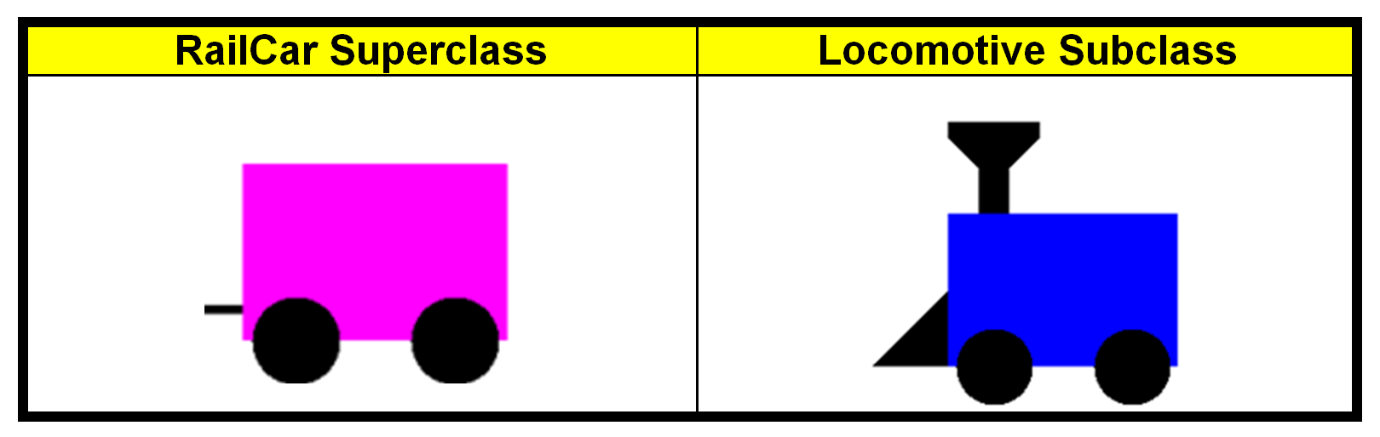
Train Case Study – Stage 4
Create a Locomotive class.

Slide 52
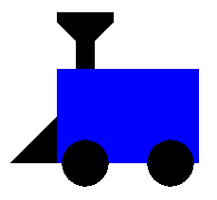
// Java1416.java
// Train case study, Stage #4
// This program adds the <Locomotive>
// class, using inheritance, since a locomotive
// is-a railcar.
import java.awt.*;
import java.applet.*;
public class Java1416 extends Applet
{
public void paint(Graphics g)
{
Locomotive loc = new Locomotive(Color.blue,70,250);
loc.drawCar(g);
}
}
class Locomotive extends RailCar
{
private Color carColor;
private int xPos;
private int yPos;
public Locomotive(Color cC, int xPos, int yPos)
{
super(cC,xPos,yPos);
carColor = cC;
this.xPos = xPos;
this.yPos = yPos;
}
public void drawCar(Graphics g)
{
super.drawCar(g);
drawScoop(g);
drawFunnel(g);
}
private void drawScoop(Graphics g)
{
Polygon scoop = new Polygon();
scoop.addPoint(xPos,yPos+50);
scoop.addPoint(xPos,yPos+100);
scoop.addPoint(xPos-50,yPos+100);
g.setColor(Color.black);
g.fillPolygon(scoop);
}
private void drawFunnel(Graphics g)
{
Polygon funnel = new Polygon();
funnel.addPoint(xPos+20,yPos);
funnel.addPoint(xPos+20,yPos-30);
funnel.addPoint(xPos,yPos-50);
funnel.addPoint(xPos,yPos-60);
funnel.addPoint(xPos+60,yPos-60);
funnel.addPoint(xPos+60,yPos-50);
funnel.addPoint(xPos+40,yPos-30);
funnel.addPoint(xPos+40,yPos);
g.setColor(Color.black);
g.fillPolygon(funnel);
}
}

Slide 53
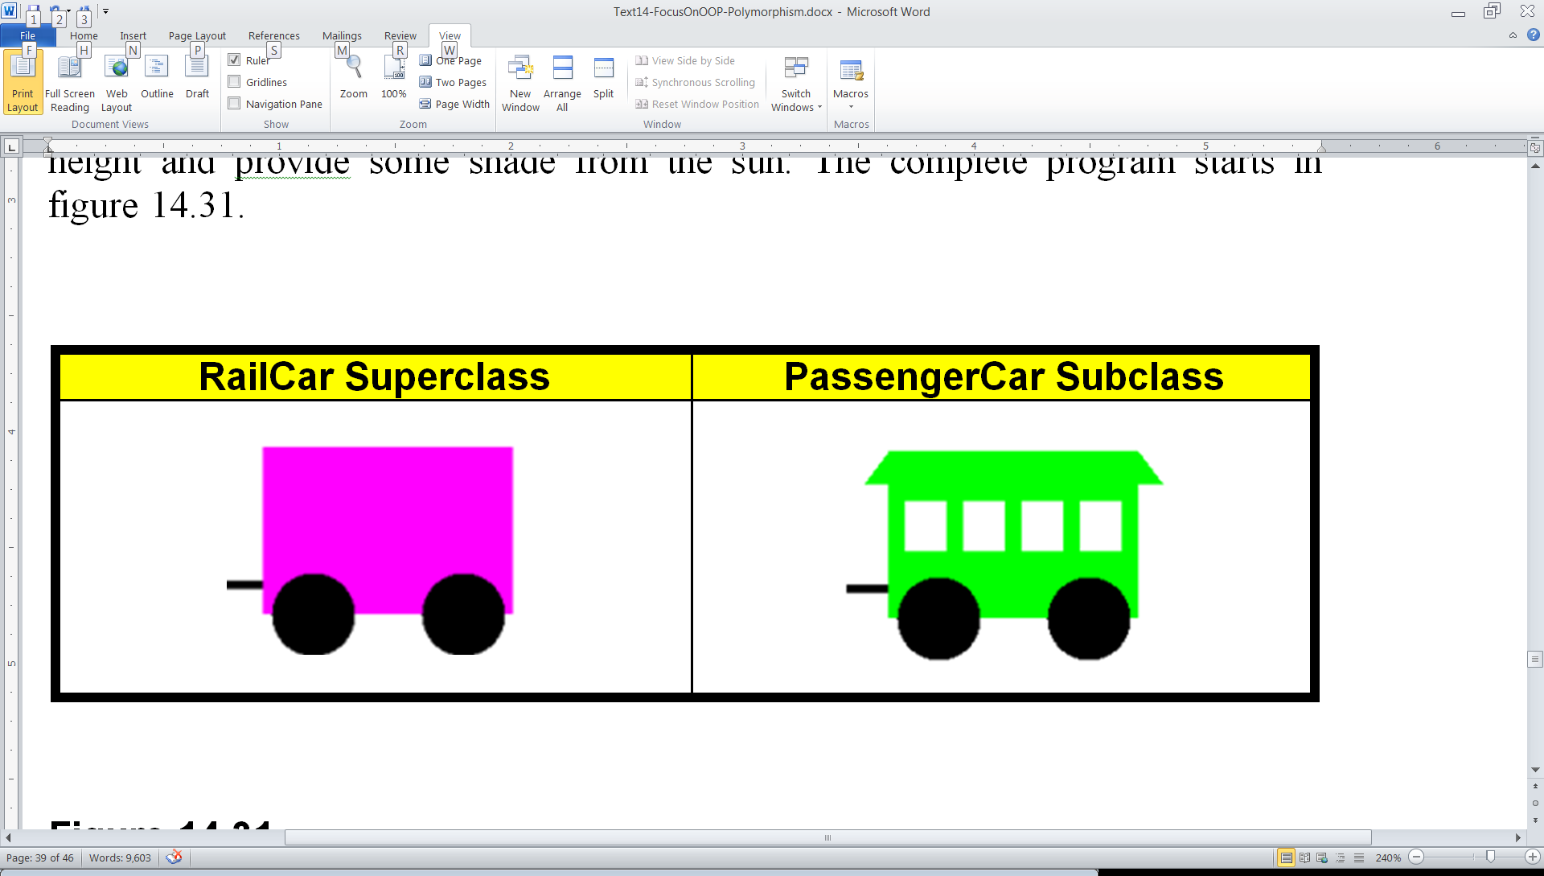
Train Case Study – Stage 5
Create a PassengerCar class.

Slide 54
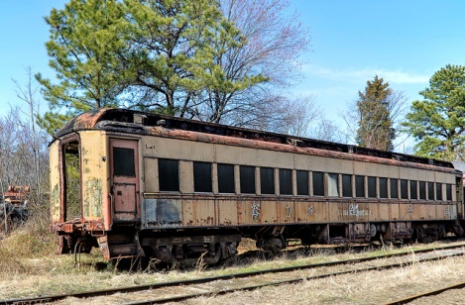
// Java1417.java
// Train case study, Stage #5
// This program adds the <PassengerCar> class,
// using inheritance, since a passenger car "is-a" rail car.
import java.awt.*;
import java.applet.*;
public class Java1417 extends Applet
{
public void paint(Graphics g)
{
PassengerCar passenger =
new PassengerCar(Color.green,580,250);
passenger.drawCar(g);
}
}
class PassengerCar extends RailCar
{
private Color carColor;
private int xPos;
private int yPos;
public PassengerCar(Color cC, int xPos, int yPos)
{
super(cC,xPos,yPos);
carColor = cC;
this.xPos = xPos;
this.yPos = yPos;
}
public void drawCar(Graphics g)
{
super.drawCar(g);
drawWindows(g);
drawRoof(g);
}
private void drawWindows(Graphics g)
{
g.setColor(Color.white);
g.fillRect(xPos+10,yPos+30,25,30);
g.fillRect(xPos+45,yPos+30,25,30);
g.fillRect(xPos+80,yPos+30,25,30);
g.fillRect(xPos+115,yPos+30,25,30);
}
private void drawRoof(Graphics g)
{
Polygon roof = new Polygon();
roof.addPoint(xPos-15,yPos+20);
roof.addPoint(xPos,yPos);
roof.addPoint(xPos+150,yPos);
roof.addPoint(xPos+165,yPos+20);
g.setColor(carColor);
g.fillPolygon(roof);
}
}

Slide 55
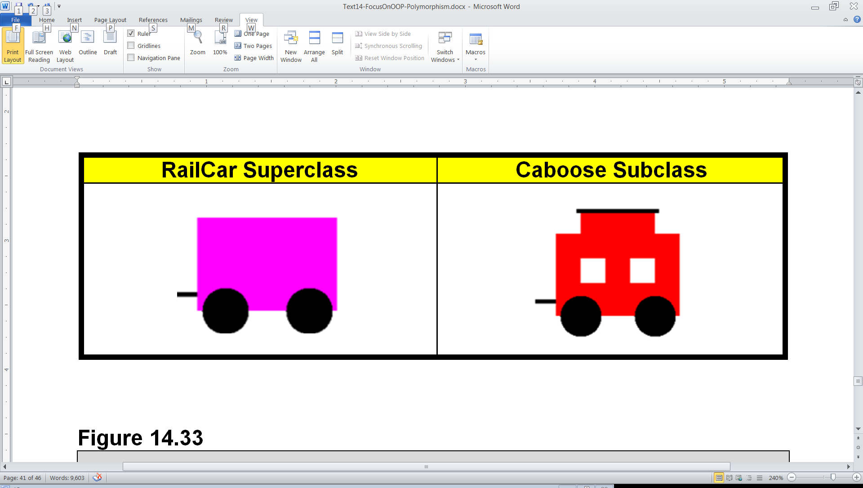
Train Case Study – Stage 6
Create a Caboose class.

Slide 56
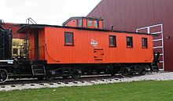
// Java1418.java
// Train case study, Stage #6
// This program adds the <Caboose> class,
// using inheritance, since a caboose "is-a"
// rail car.
import java.awt.*;
import java.applet.*;
public class Java1418 extends Applet
{
public void paint(Graphics g)
{
Caboose cab =
new Caboose(Color.red,580,250);
cab.drawCar(g);
}
}
class Caboose extends RailCar
{
private Color carColor;
private int xPos;
private int yPos;
public Caboose(Color cC, int xPos, int yPos)
{
super(cC,xPos,yPos);
carColor = cC;
this.xPos = xPos;
this.yPos = yPos;
}
public void drawCar(Graphics g)
{
super.drawCar(g);
drawWindows(g);
drawCupola(g);
}
private void drawWindows(Graphics g)
{
g.setColor(Color.white);
g.fillRect(xPos+30,yPos+30,30,30);
g.fillRect(xPos+90,yPos+30,30,30);
}
private void drawCupola(Graphics g)
{
g.setColor(Color.red);
g.fillRect(xPos+30,yPos-30,90,30);
g.setColor(Color.black);
g.fillRect(xPos+25,yPos-30,100,5);
}
}

Slide 57
Section 14.8
A Polymorphic
Choo-Choo Train

Slide 58
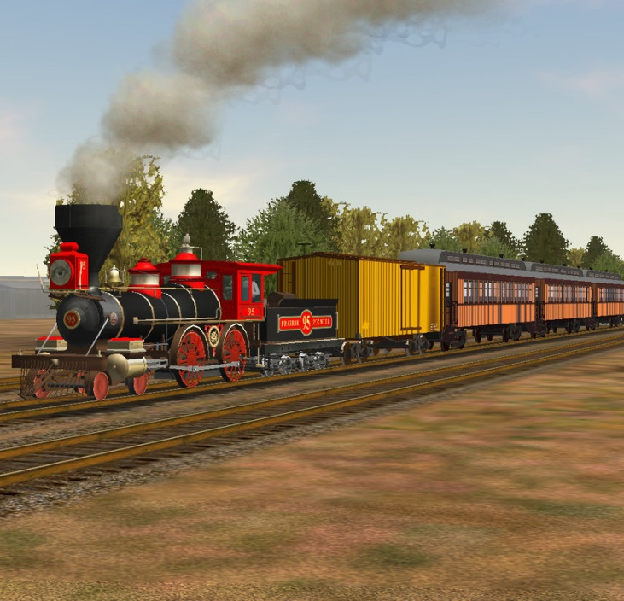
// Java1419.java
// Train case study, Stage #7
// The train case study is now ready to display.
// <RailCar> is the umbrella class and <drawCar> is the polymorphic method.
import java.awt.*;
import java.applet.*;
import java.util.ArrayList;
public class Java1419 extends Applet
{
public void paint(Graphics g)
{
ArrayList<RailCar> railCars = new ArrayList<RailCar>();
railCars.add(new Locomotive(Color.blue,100,300));
railCars.add(new PassengerCar(Color.gray,275,300));
railCars.add(new PassengerCar(Color.gray,450,300));
railCars.add(new PassengerCar(Color.gray,625,300));
railCars.add(new FreightCar(Color.green,800,300));
railCars.add(new FreightCar(Color.green,975,300));
railCars.add(new Caboose(Color.red,1150,300));
for (RailCar railCar : railCars)
railCar.drawCar(g);
}
}

Slide 59
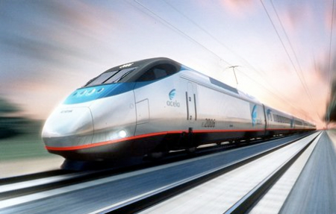
// Java1420.java Train case study, Stage #7b
// All the train classes are the same in Stage #7b.
// Polymorphism is now shown with the <drawTain> method.
// The umbrella is the same <RailCar> class.
public class Java1420 extends Applet
{
public void paint(Graphics g)
{
RailCar railCar1 = new Locomotive(Color.blue,100,300);
RailCar railCar2 = new PassengerCar(Color.gray,275,300);
RailCar railCar3 = new PassengerCar(Color.gray,450,300);
RailCar railCar4 = new PassengerCar(Color.gray,625,300);
RailCar railCar5 = new FreightCar(Color.green,800,300);
RailCar railCar6 = new FreightCar(Color.green,975,300);
RailCar railCar7 = new Caboose(Color.red,1150,300);
drawTrain(g,railCar1);
drawTrain(g,railCar2);
drawTrain(g,railCar3);
drawTrain(g,railCar4);
drawTrain(g,railCar5);
drawTrain(g,railCar6);
drawTrain(g,railCar7);
}
public void drawTrain(Graphics g, RailCar railCar) { railCar.drawCar(g); }
}

